Slide 1
Using Remote Sensing for Bathymetry Estimation in Coastal Environments.
2016 Industrial Math/Stat Modeling Workshop for Graduate Students
Raleigh, North Carolina
07/19/2016
Lea Jenkins
Department of Mathematical Sciences
Clemson University
Ty Hesser, Matthew Farthing
Coastal and Hydraulics Laboratory
Engineer Research and Development Center

Slide 2
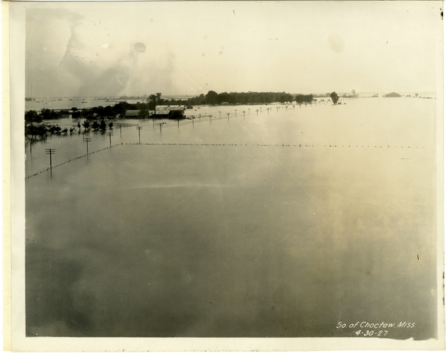
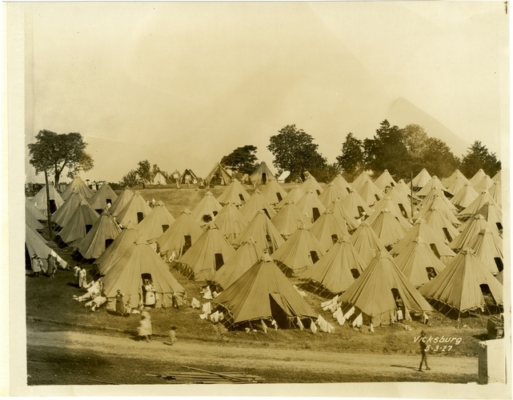
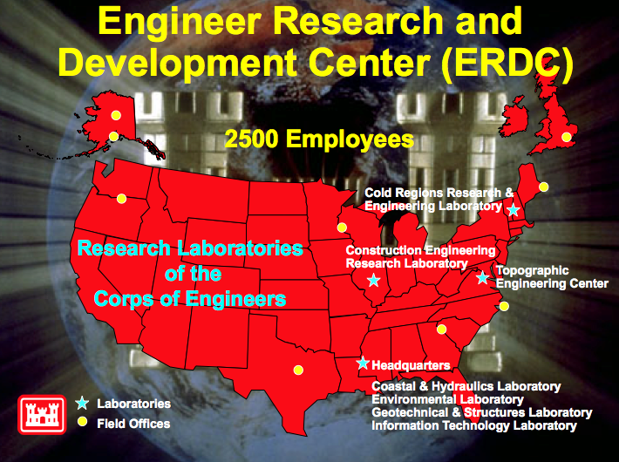
What is ERDC?
1930
Established by Congress as the
Waterways Experiment Station (WES)
Mississippi Delta, 1927
Vicksburg, 1927
Today
Applied R&D Organization for the Corps of Engineers, DoD
Civil Engineers, Physicists, Mathematicians, Anthropologists …

Slide 3
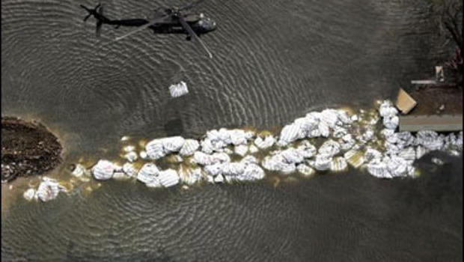
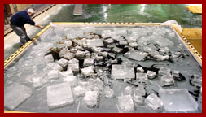
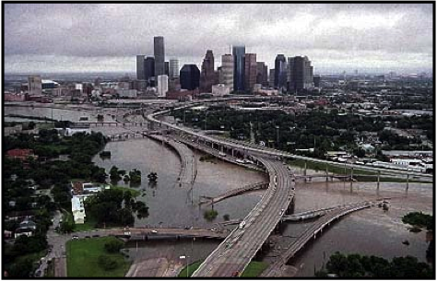
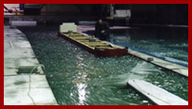
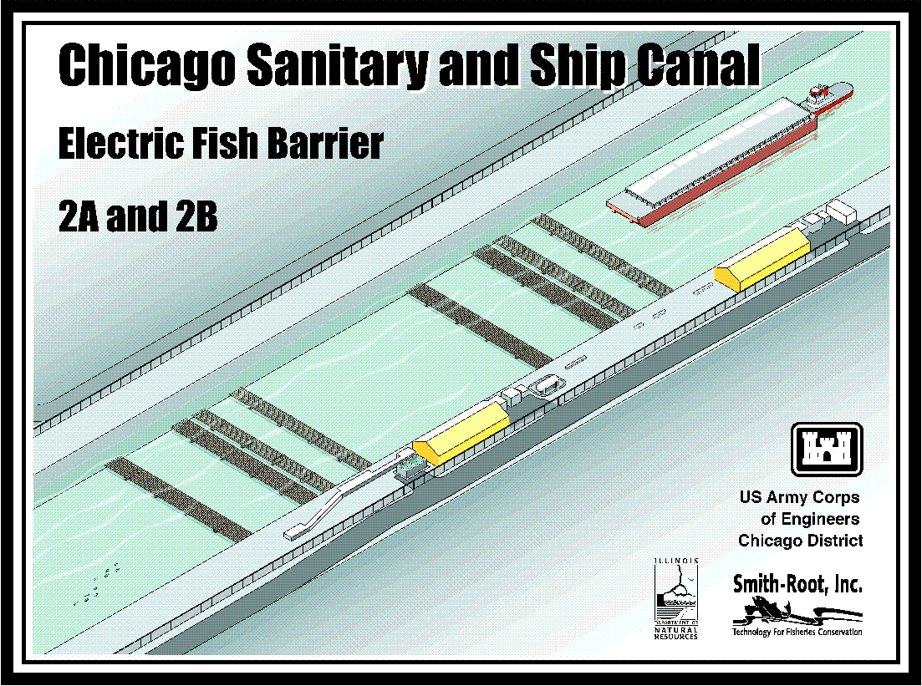
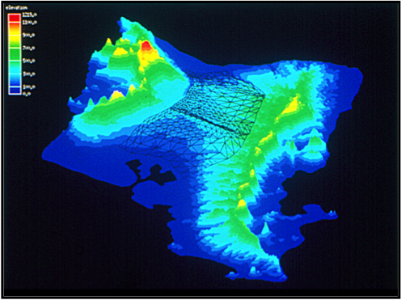
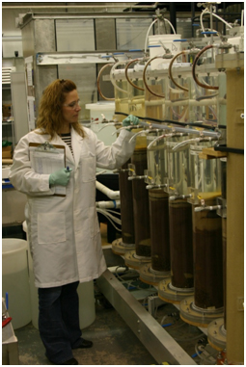
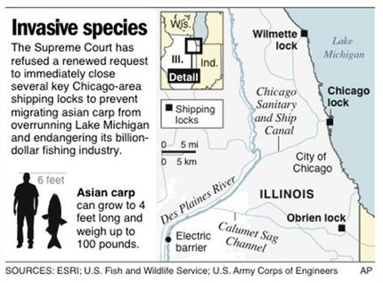
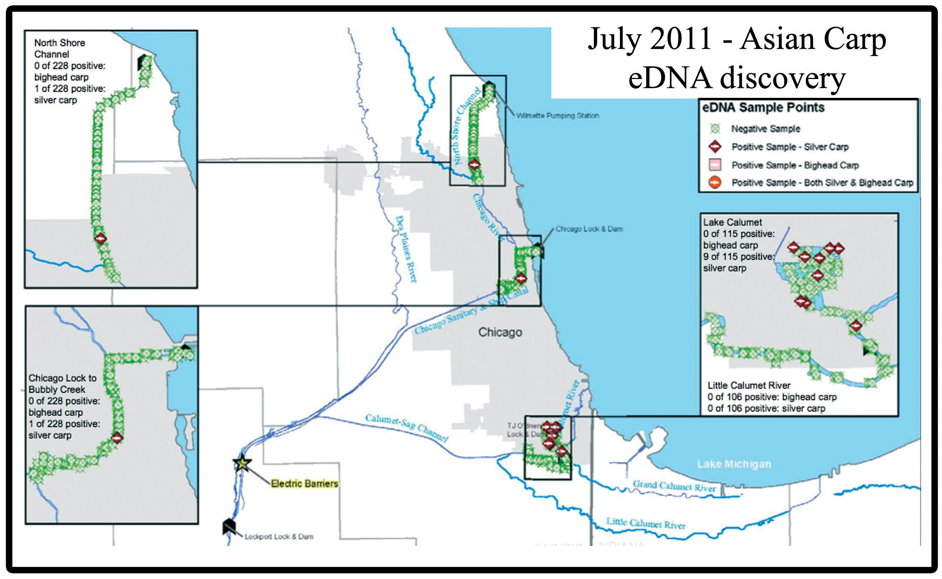
Civil Works Mission
Flood and Storm Damage Reduction and Dredging
Ice Hydraulics and Engineering
Environmental Contamination
Invasive Species

Slide 4
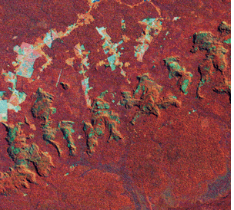
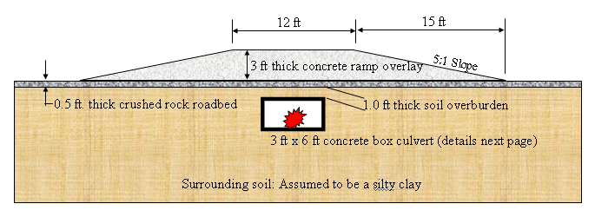
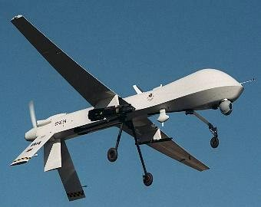
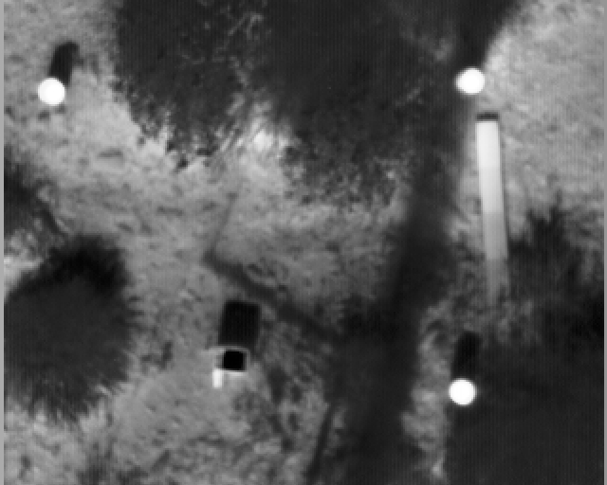
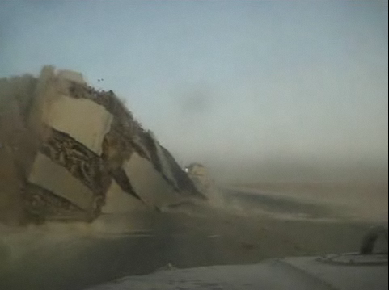
Military Applications
Force Protection
No Overlay
With Overlay
Remote Sensing for Threat Detection and Engineering Analysis
Notes:
Airborne or vehicle-mounted
Electro-optical, infrared, and radar are most common
Flightlines are 10s of meters by 1000s of meters – generates a lot of imagery
Automated target recognition (ATR) algorithms for image analysis

Slide 5
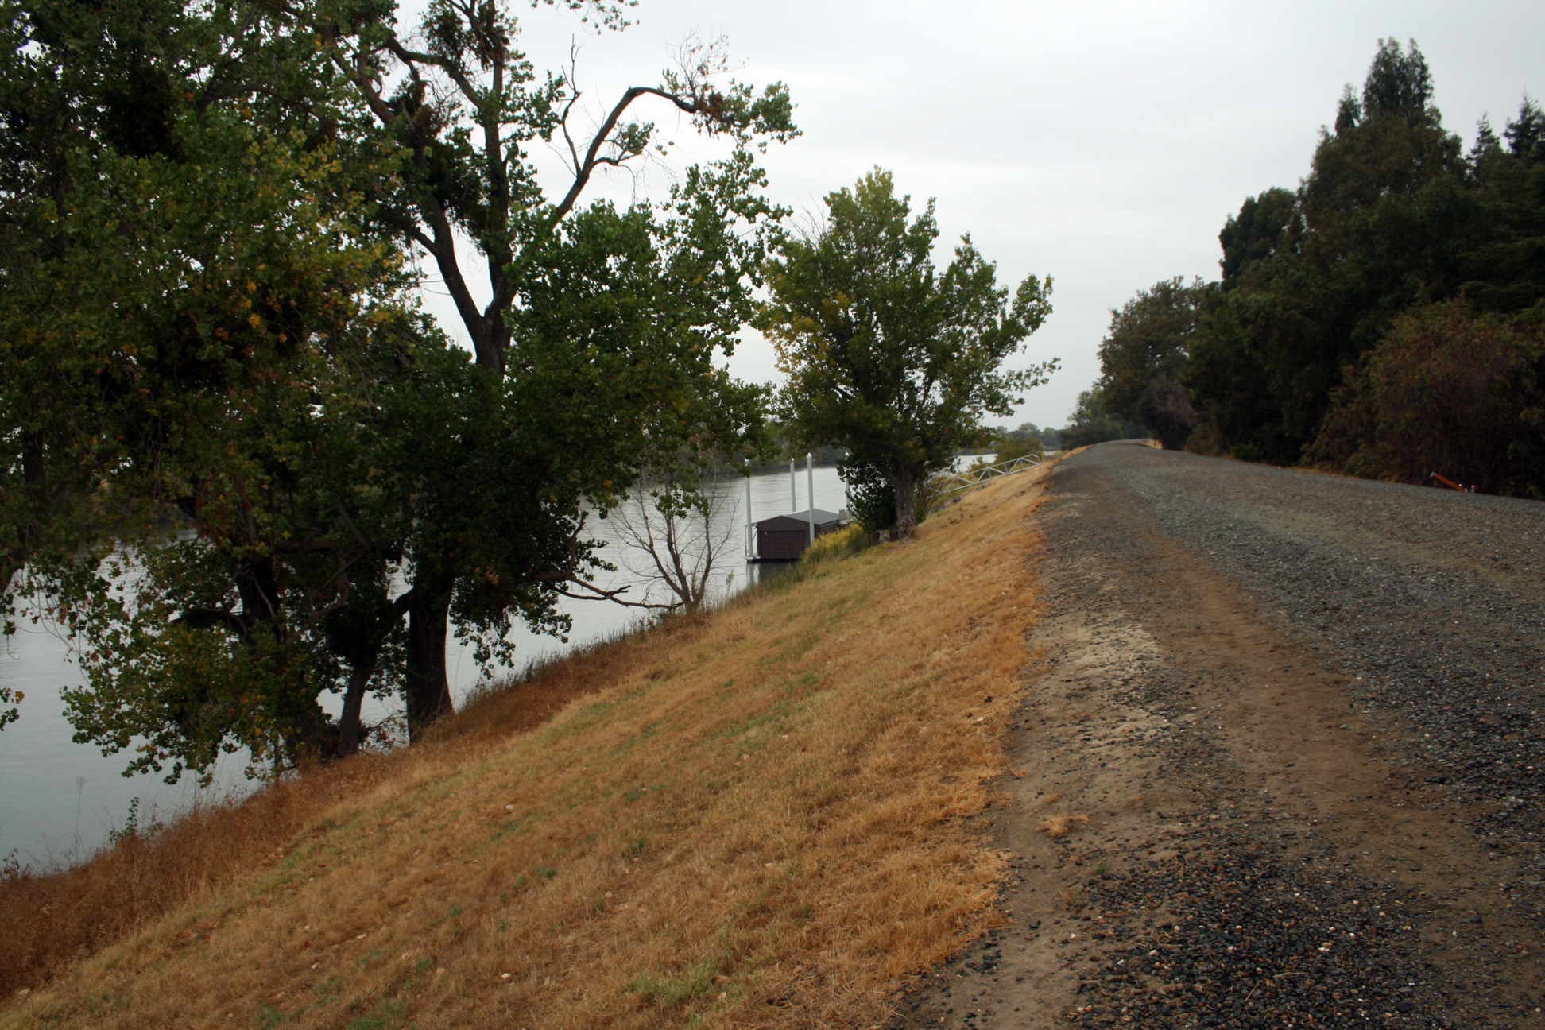
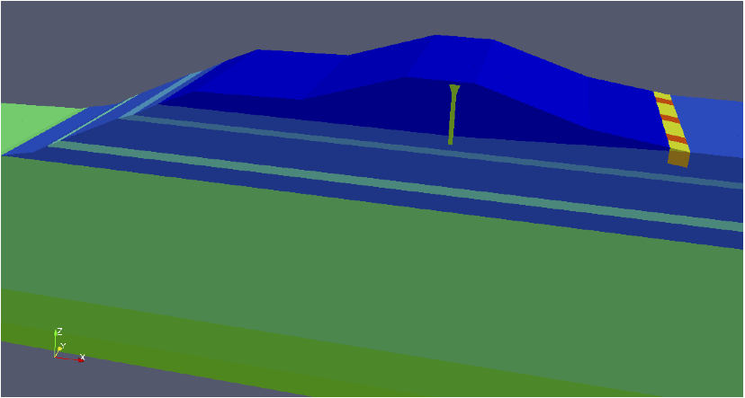
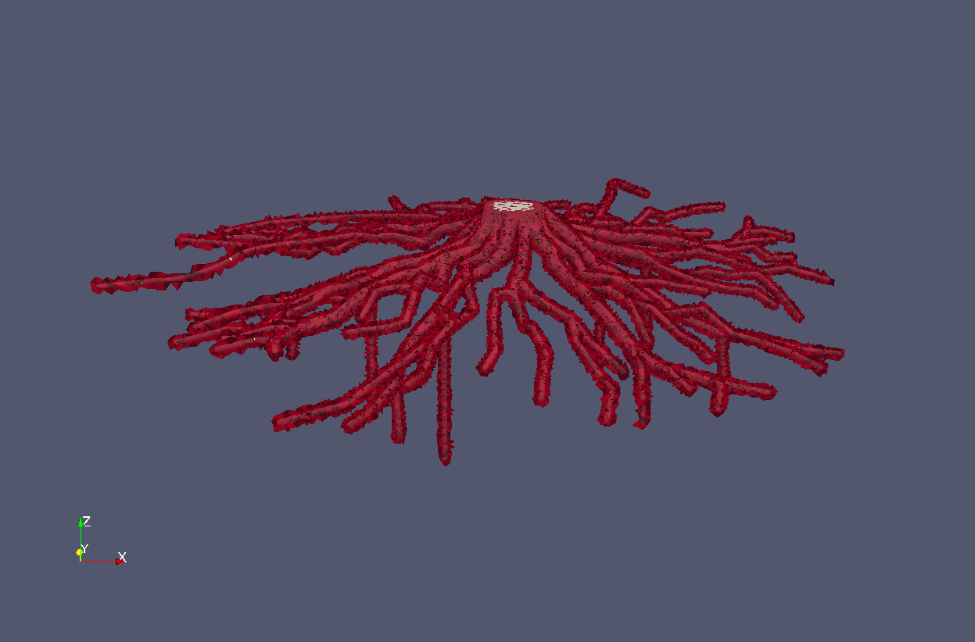
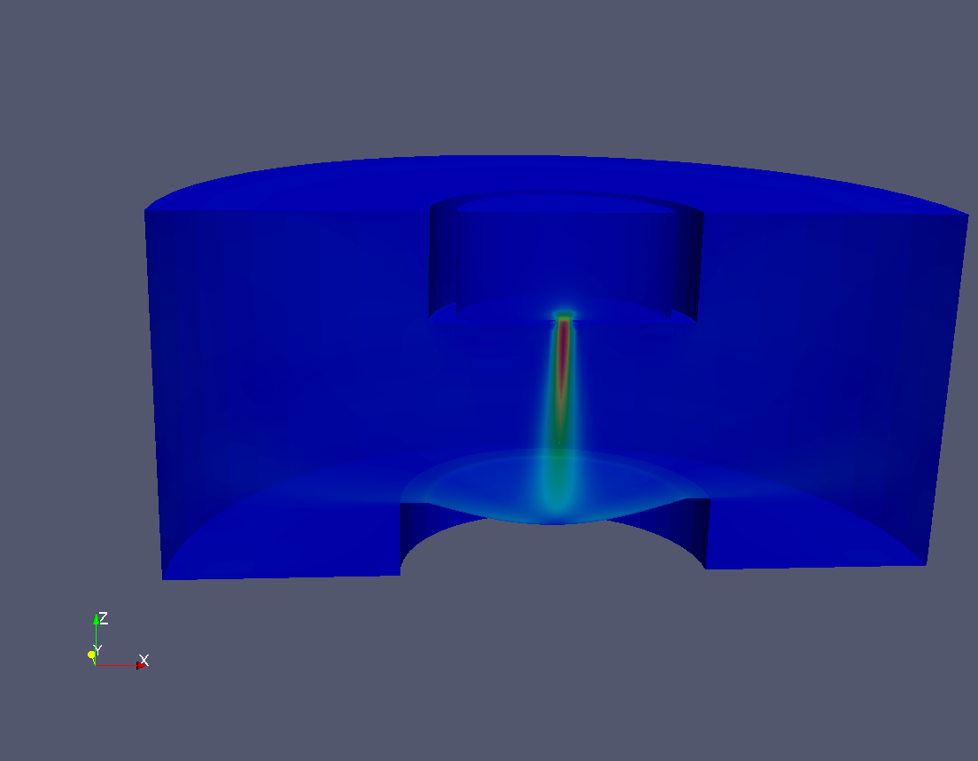
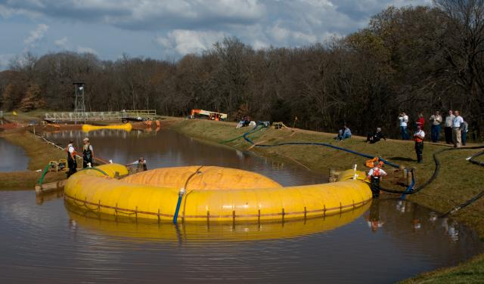
What do we have to offer?
Levee Safety and Protection
Large (and small) scale experimental facilities
HPC and computational modeling resources
Interesting Problems
Sacramento Pocket Levee
Pocket levee domain with periodic vegetation zone.
1:16 Scale Breach Model
Levee breach in Sacramento-San Joaquin River Delta
ERDC Full Scale Breach Test Facility
Lab-Scale Surface Erosion Testing
Notes:
Multiphysics simulation on km scale domains with localized cm scale resolution
Variably saturated subsurface flow
Nonlinear soil mechanics (elasto-plastic deformation)
Soil-root zone 167, 237 elements
Computational mesh ~15 million tetrahedral elements

Slide 6
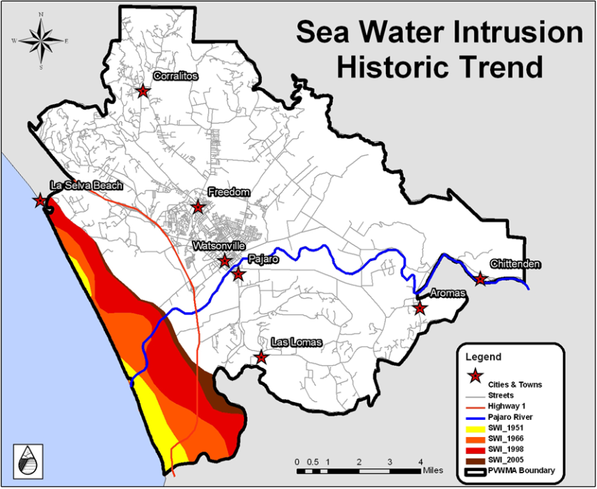
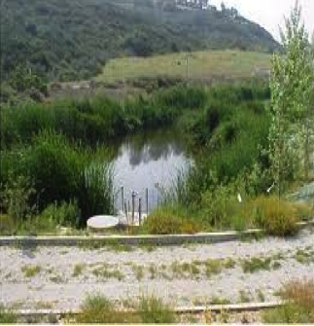
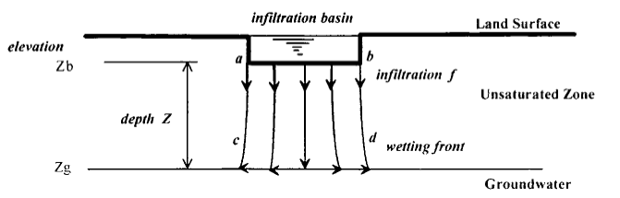
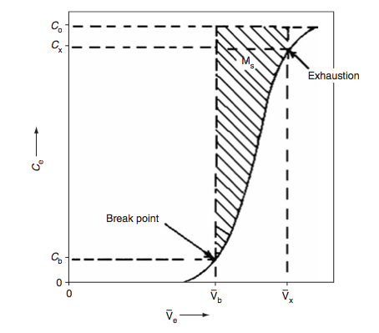
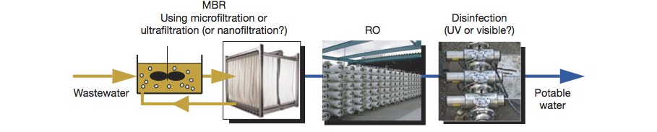
Previous IMSM Projects
Improving Access to Fresh Water
IMSM 2012
IMSM 2013
Managed Aquifer Recharge
Well placement and design for mitigating Seawater Intrusion,
IMSM 2014
Optimal Design of Water Filtration Systems
Notes:
Water Supply Solutions
Increasing access to clean water
reduction of saltwater intrusion in
coastal aquifer by managing well
pumping
Managed recharge to replenish
freshwater supplies
Last time, looked at ways to treat polluted/low quality
water.
Point of Use, solution?

Slide 7
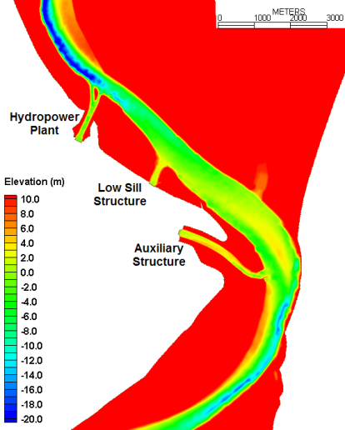
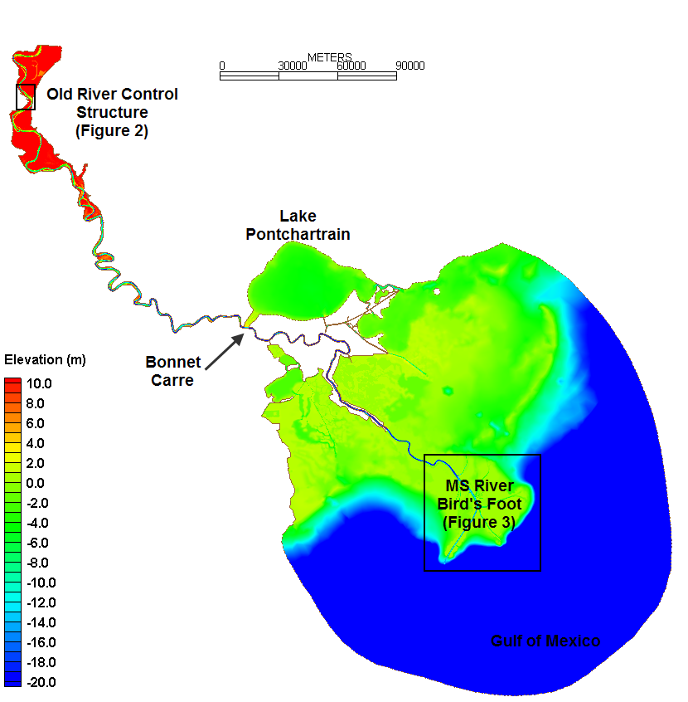
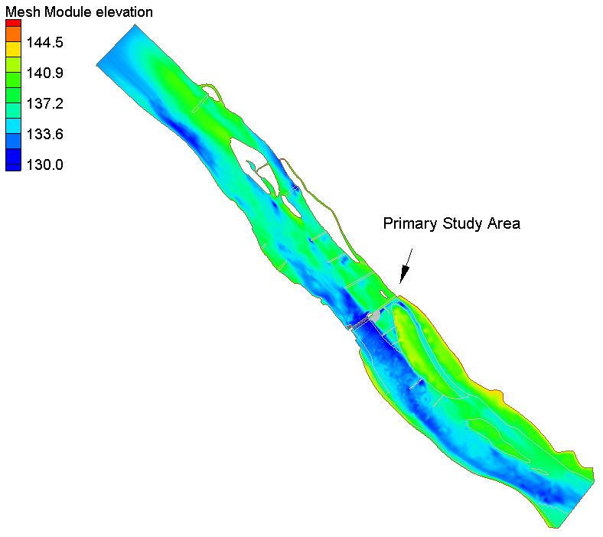
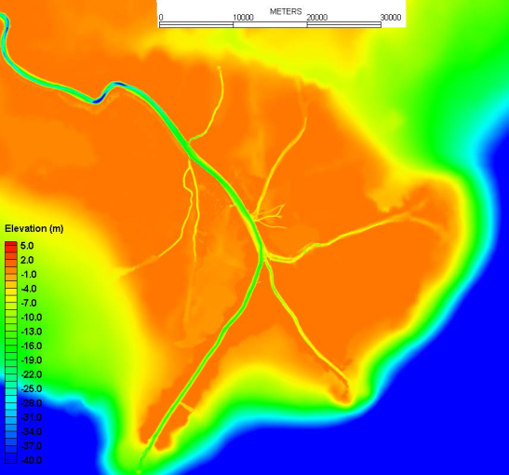
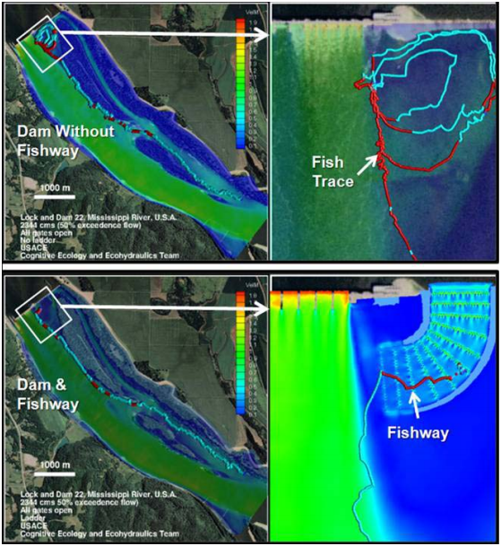
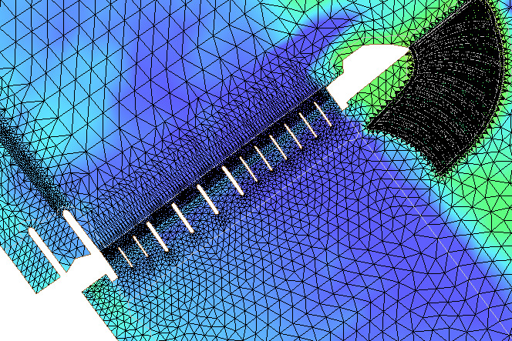
Environmental Modeling Challenges
Large domains to capture system behavior
Detailed resolution and physics needed for
engineering analysis
400 river miles from upstream of Old River Control to Gulf of Mexico
9.3+ million acres
100 m resolution in river
Base versus Plan Study for Fish Passage
Notes:
480,411 elements
245,465 nodes

Slide 8
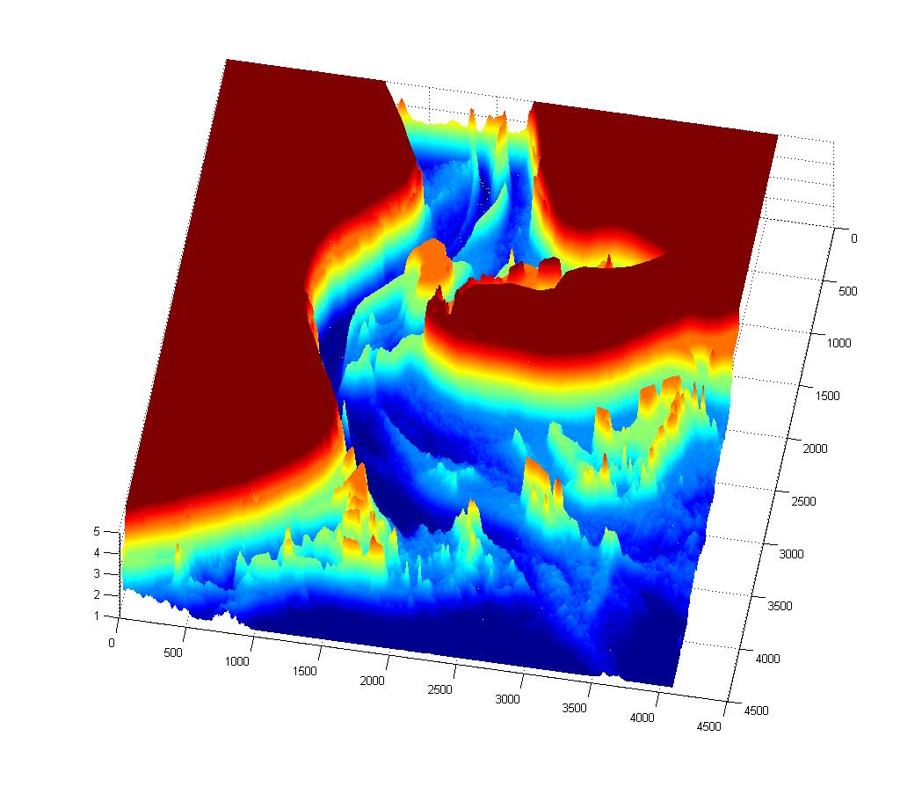
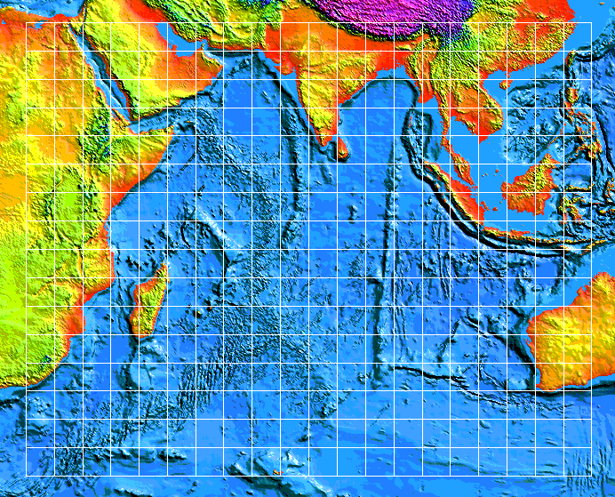
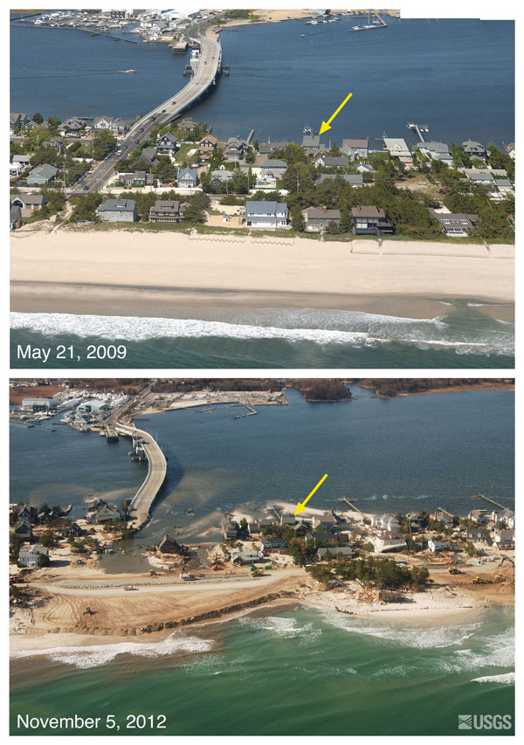
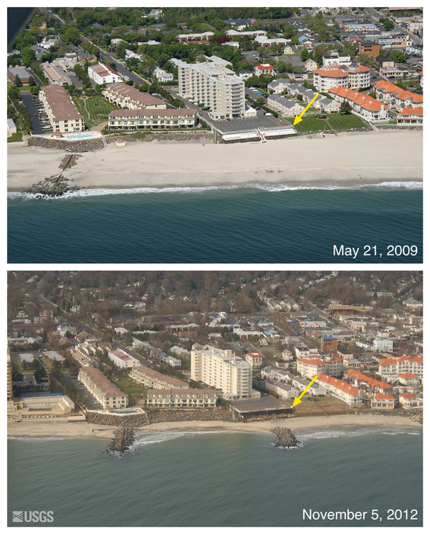
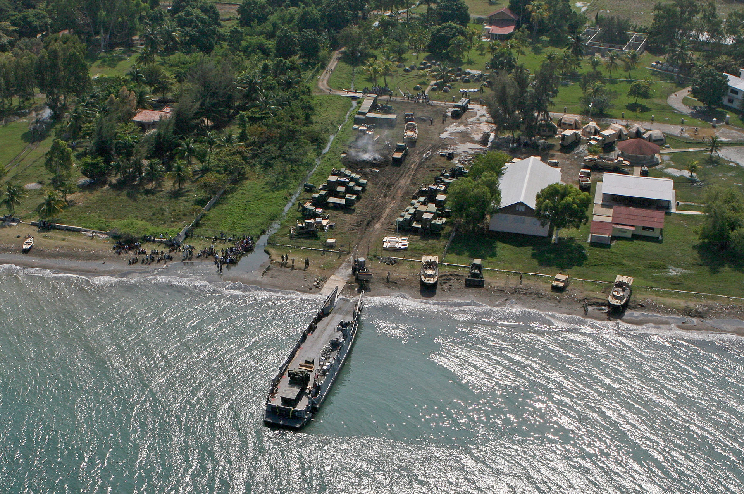
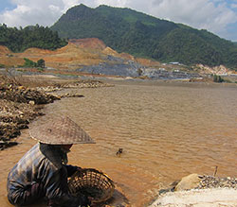
Bathymetry and Why Do We Care?
We can measure bathymetry directly, but in-situ measurements can be costly to make and update.
Bathymetry→ submarine topography
Bathymetry, New River Inlet, NC
GEBCO, globally available at 30 arc sec (~ 1km)
Logistics for Humanitarian Aid, Haiti 2010
Super-storm Sandy led to wide spread beach erosion from Virginia to New York.
Predicting impacts of dams on fish passage along Mekong
Notes:
Bathymetry is the distance from a reference point
to the bottom of a body of water
Airport overwhelmed
One runway functional
No place to put aid shipments
Post-Sandy Beach Erosion over large spatial range from Virginia to New York (rapid temporal, large spatial

Slide 9
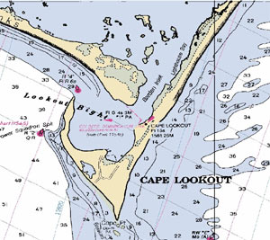
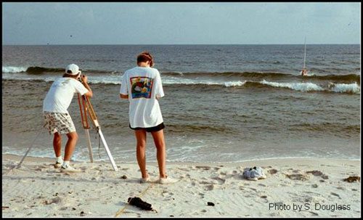
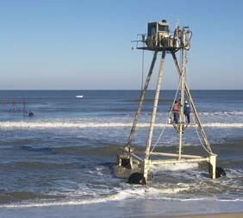
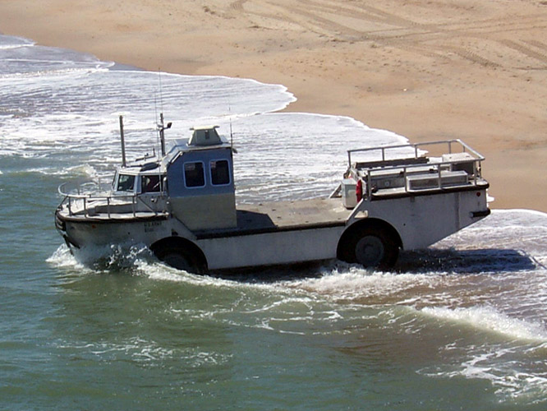
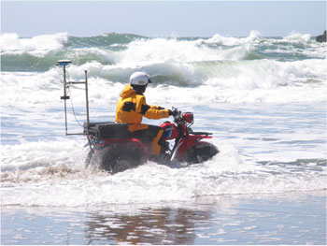
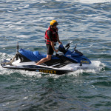
Measurement of Littoral Bathymetry
Nautical Charts
Rod and Level
Real Time Kinematic -Global Positioning System (RTK-GPS)
CRAB or LARC
Jet-ski, ATV, backpack
All are either not accurate, expensive, or only cover limited regions
Notes:
Need to add something about satellites, make more general

Slide 10
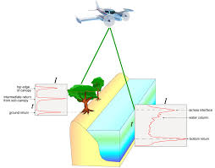
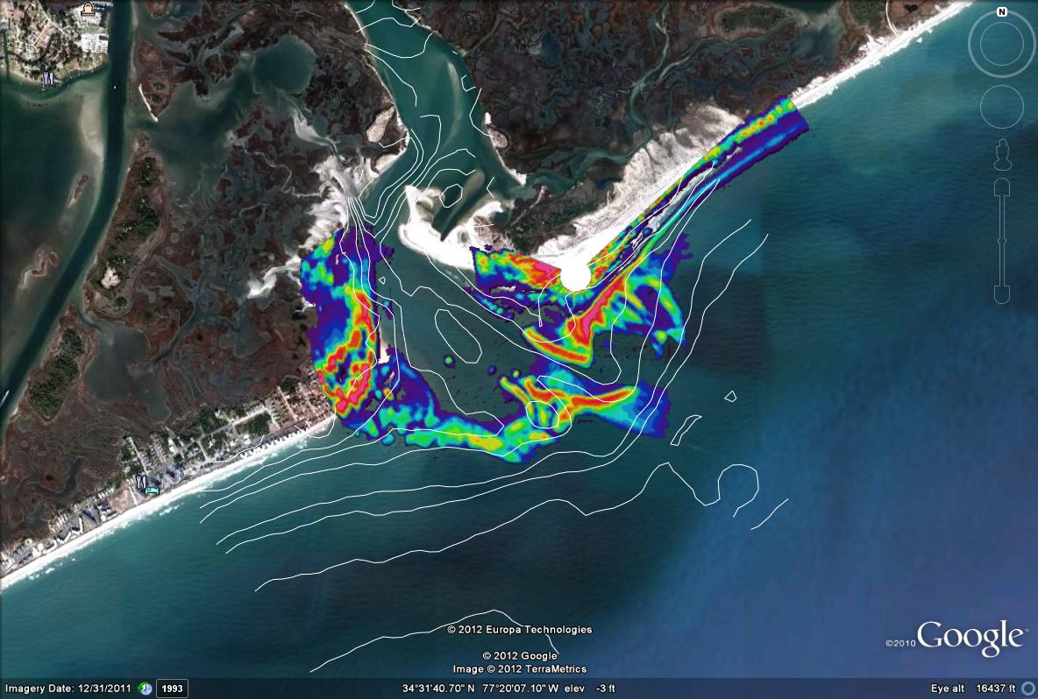
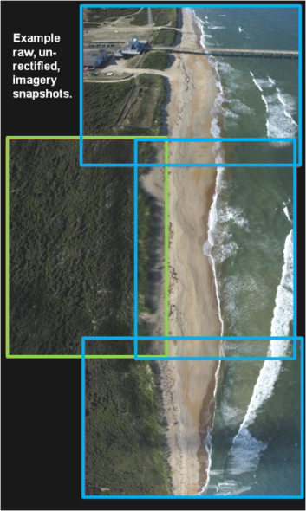
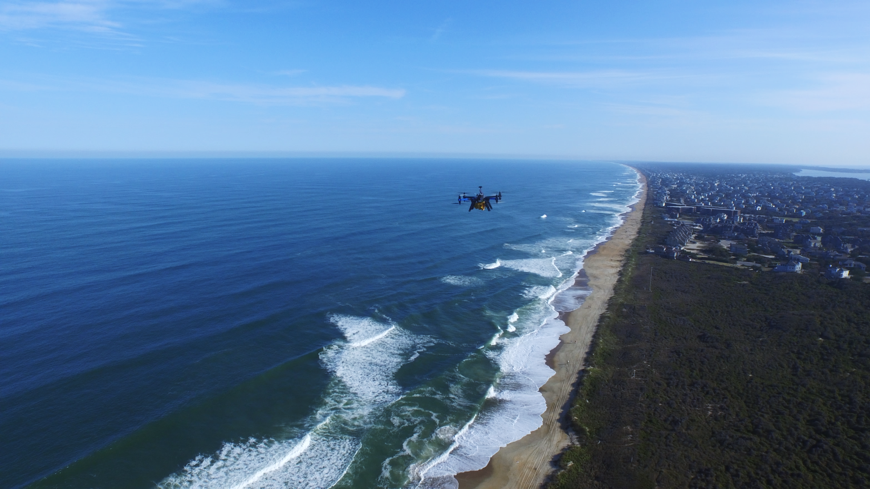
Sensing in the Littoral Zone
Surface wave characteristics and topography from mounted LiDAR and radar stations
Surface wave characteristics from photogrammetric and LIDAR airborne platforms (manned and unmanned vehicles)
Satellites
Notes:
Need to add something about satellites, make more general

Slide 11
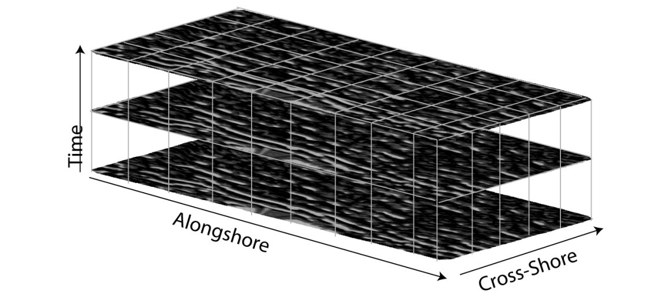



‘Direct’ Inversion Techniques
Estimation of depth from linear regression of blue and green reflectance
Estimated bathymetry using image analysis to extract wave angle and speed and assuming simplified linear wave theory

Slide 12






Remote Measurements
When we can’t afford in-situ measurements, we can try to estimate bathymetry from remotely sensed data.
Remote --- satellite platform
Standoff --- airborne platform
Optical (blue) and IR measurements from Landsat
Wave Breaking Dissipation from Radar
Thermal IR for locating surface eddies

Slide 13
What Are Some of the Issues?
Limitations of common image-analysis approaches
Clarity of water, Clouds, Surf zone
Frequency of observation, resolution
Linear-wave theory approaches fail in areas where wave-current interaction is important
Need to increase fidelity of physics to extend the range where inversion is possible (valid)
Model-Based Inversion
Example error in an inlet for wave-speed inversion from radar

Slide 14
Hydrodynamics (Forward Problem)
Shallow Water Equations
where
Wave Action Balance Equation

Slide 15


Model Based Bathymetric Inversion
Estimate depths and other material properties for mobility in the near-shore
Combine direct estimation from measurements with model-based inversion

Slide 16

Goals
We’d like to be able to estimate the bathymetry in natural environments when we direct measurement is difficult or very costly
We are largely restricted to measurements of surface properties at varying resolution
We would like to have a hierarchy of estimates from cheap, readily available to highly reliable (and probably expensive)
Things we can explore
Direct estimation of bathymetry from images
Model-based inversion
How do we solve the inverse problem?
How do we approximate the hydrodynamics?

Slide 17


What Needs To Be Done?
Formulate inverse problem for bathymetry in the near-shore
Look at as nonlinear least squares and/or joint state-parameter estimation
Requires modeling free-surface hydrodynamics, representation of bathymetric variability
Move from simplified models in terms of physics and dimensionality to full two-dimensional, large-scale domains
Semi-analytical solutions for idealized examples to full numerical solution
Survey Data, Field Research Facility, Duck NC

Slide 18
Backup SLIDes

Slide 19





Remote Sensing Sensor Fusion – Approach Trajectory
Data Description
+
–
1 = water (low wt) 2 = land (high wt) 3 = shallow (med wt) 4 = exposed sand / breaking waves (high wt) | Spatially continuous Space-based data collection Passive technology | Empirical Depth Proxies User-defined thresholds
Warm colors = more breaking = shallower (high wt) Cool colors = less breaking = deeper (low wt) | Spatially continuous High dynamic range in intensity levels | Depth proxy Active technology (could be done from persistent look EO imagery FY14?)
Depth retrieval & confidence score from wave speed inversion (calculated wt) Also: wave speed, direction, period | Actual depths Physics-based Can be coupled with numerical model (FY14) | Spatially limited Roughened waves must be present Poor performance in deep sheltered water (need shallow or intermediate surface gravity waves)
Current speeds and direction from EO/IR optical flow analysis Faster currents = deeper channel | Night or day collection Passive technology | Poor far range resolution and emmisive signature; airborne platform with persistent down-look capabilities (FY14?)
Topographic and bathymetric elevations from an airborne platform Quadcopter/CZMIL system | Actual depths Depending on Secchi depth, could observe deeper channel depths | Must fly low for better range into water column Cannot penetrate murky or white water environments Photogrammetry needs GCPs for best accuracy
Satellite/Aerial
Classification
Radar
Dissipation
Combine data types using weights to determine best approach trajectory and expected depths
Radar Wave
Speed Inversion
Ultimate GOAL:
Combine with
high-fidelity numerical model to validate model solution
IR Current Speed
Lidar/
Photogrammetry
Elevations

